Slide 1

Understanding Python With a Number Guessing Game
Get Ready to Code: An Exciting Introduction to Programming Fun
Presented by:
Bikash Das (ADTU/0/2024-28/BCSM/071)
Nayandeep Goswami (ADTU/0/2024-28/BCSM/047)
Suraj Choudhary (ADTU/0/2024-28/BCSM/075)
Asif Raza (ADTU/0/2024-28/BCSM/004)
Dhiman Saikia (ADTU/0/2024-28/BCSM/062)
[Presentation Date : 19/05/2025]

Slide 2







Table of Contents
This presentation covers a Python number guessing game.
Introduction
1
Game objective & interaction.
Objective
2
Purpose of the program
Tools Used
3
What are the tools used
Concepts Used
4
Random numbers, input, loops.
Flowchart
5
Let's have an overview of the game
Conclusion
6
Learnings & enhancements.

Slide 3
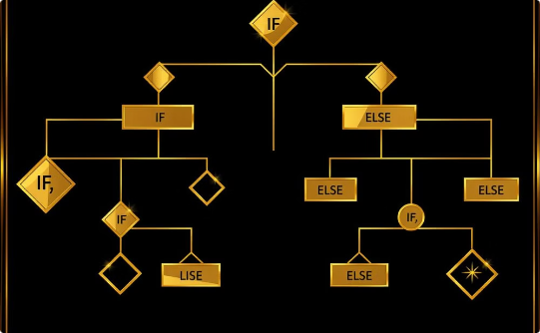
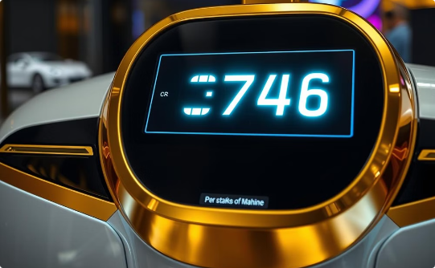

Introduction
Welcome to the Number Guessing Game! The objective is to guess a randomly generated number between 1 and 20. The game provides hints to help us refine our guesses, making it an engaging and interactive learning experience.
Interactive Fun
Random Number Generation
Strategic Hints
Engage in an interactive game that challenges your guessing skills.
Experience the excitement of guessing a new random number each time.
Receive helpful hints to guide your guesses and improve your strategy.

Slide 4

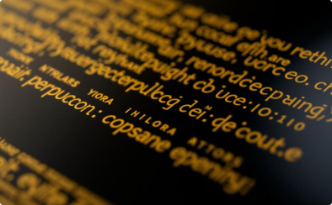

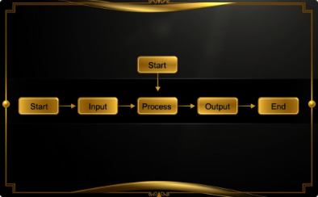
Objective
Improve Logic
Learn Programming Ideas
Applying Concepts
Algorithmic Thinking
Sharpen problem-solving skills.
Master Python through practice.
Follow the program's clear logic.
Understand loops and random choices.

Slide 5







Tools Used
Python
Random Module
Control Structures
Exception Handling
Core language for game logic and input.
Generates the number to guess.
Manages input, validates guesses, and controls game flow.
Handles invalid inputs to prevent crashes.
User Input Handling
Scoring System
Hint System
Receives player guesses.
Dynamic scoring based on attempts.
Provides clues after incorrect attempts.

Slide 6
Concepts Used
1
Random Module
2
If-Else Statements
3
While Loop
Generates pseudo-random integers using the randint() function.
Compares guesses to the target number and provides feedback accordingly.
Continues running the game until the correct guess is made or the player exits, repeatedly prompting for input.
4
OOPs
5
Tkinter
6
File Handling
Uses classes to organize game variables and methods for better structure.
Builds the game’s graphical user interface.
Saves player profiles and high scores in JSON format for persistent storage.

Slide 7
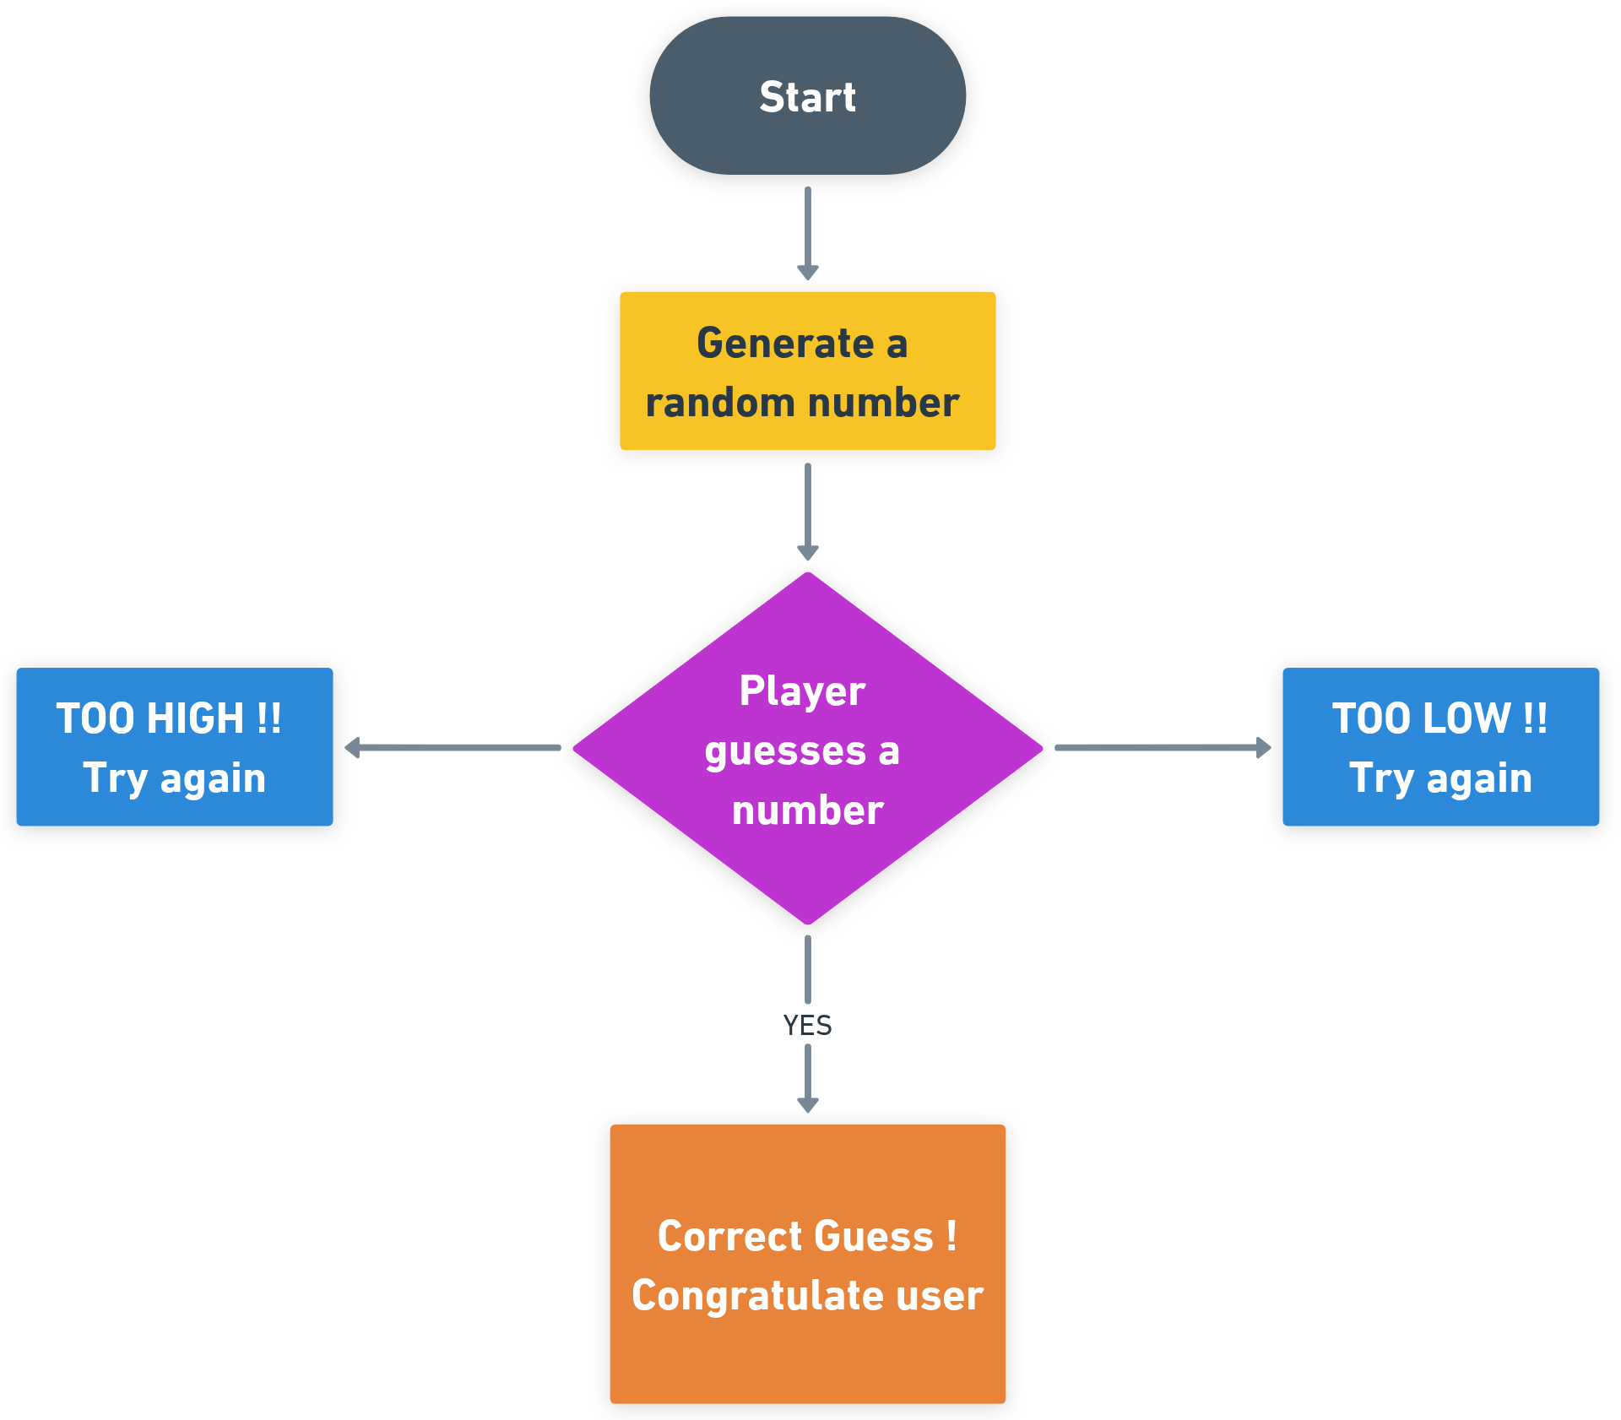

Process Flow Diagram
1
2
Random Number Generation
3
Hint-Based Feedback
Players enter a number guess between 1 and 20.
The system randomly selects a number at the start of the game.
The game provides hints (Too High / Too Low) after each guess.
User Guess Input

Slide 8
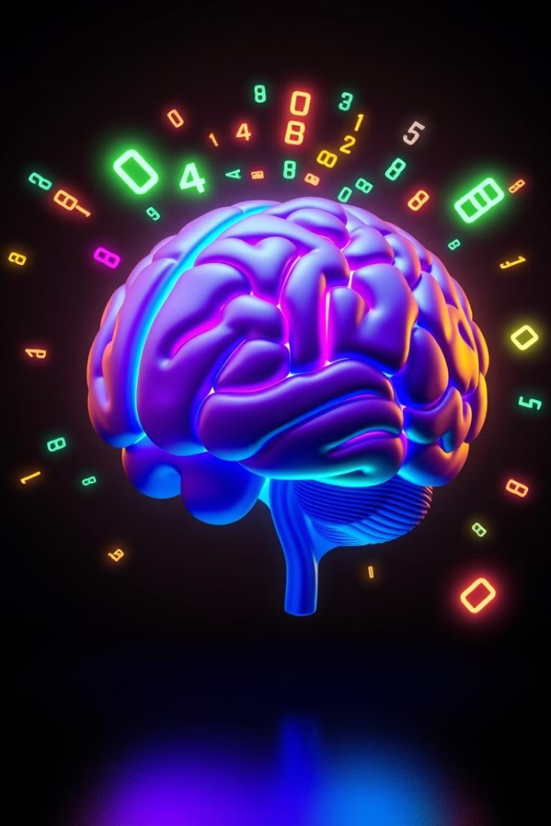
Conclusion
1
Beginner-Friendly
Simple structure and basic Python make it easy for new programmers to understand and change the code.
2
Core Concepts
Shows how to create random numbers, use while loops, and use if-else statements for user feedback.
3
Enhancements
Easily add difficulty levels, scoring, or limit the number of guesses allowed.
4
Fun Learning
Interactive and engaging, it helps learn programming through feedback and encourages understanding of conditional logic.

Slide 9
Thank You

